Slide 1
REVIEW OF MAJOR CLINICAL TRIALS 2020
DR VIVEK C WARRIER
SENIOR RESIDENT
DEPARTMENT OF CARDIOLOGY ,GMC CALICUT

Slide 2
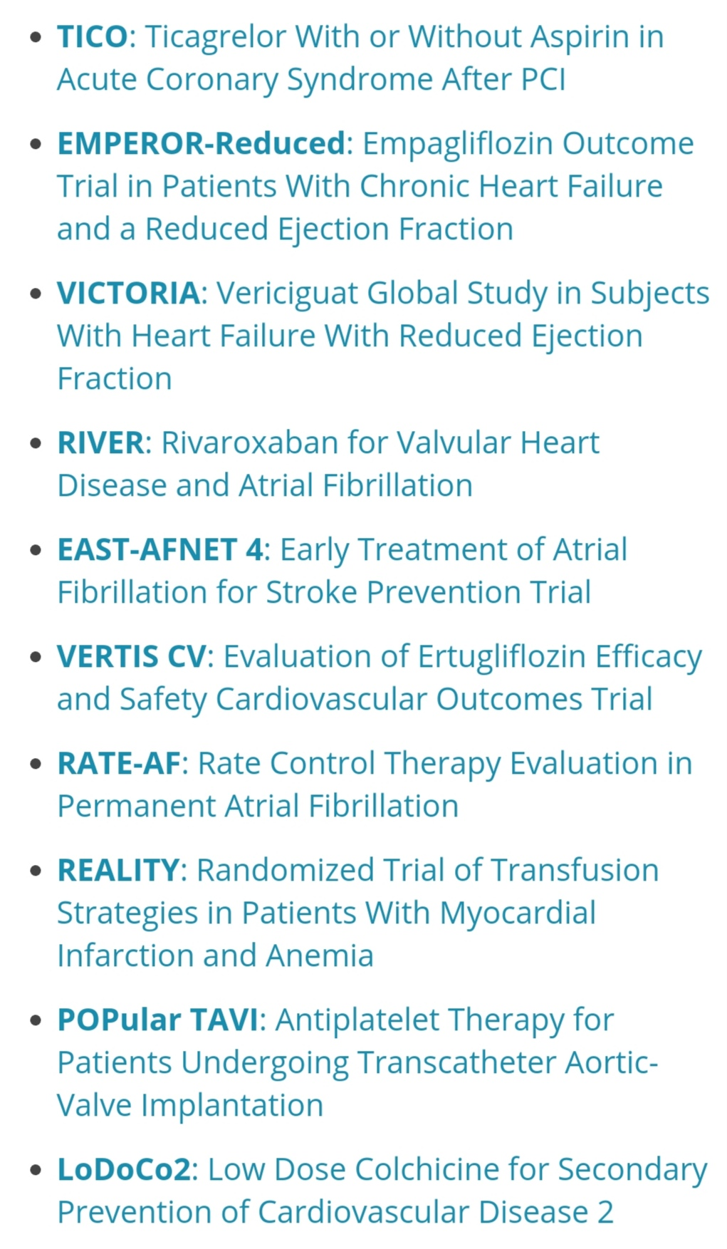

Slide 3
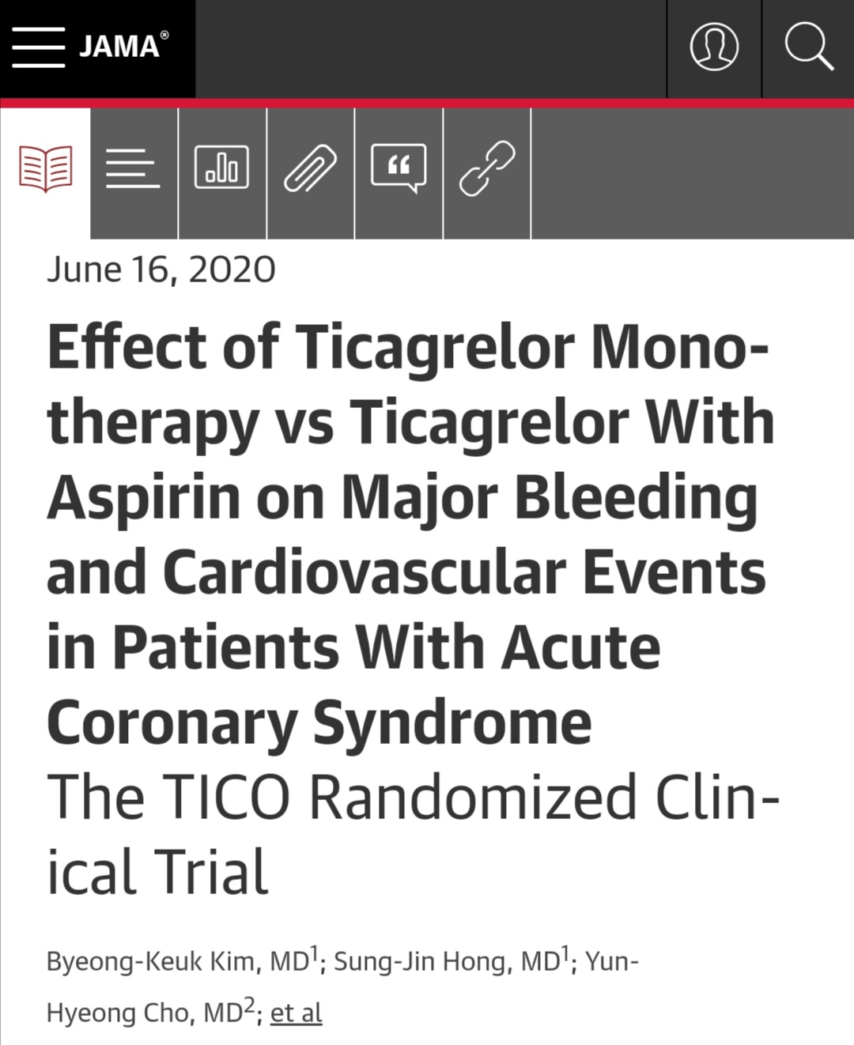

Slide 4
Contribution To Literature :
    The TICO trial showed that ticagrelor
monotherapy after 3 months of DAPT
was superior at preventing ischemia
& bleeding after PCI for ACS.

Slide 5
Description :
      The goal of the trial was to evaluate ticagrelor monotherapy after 3 months of dual antiplatelet therapy (DAPT) compared with 12 months of DAPT after percutaneous coronary intervention (PCI) for acute coronary syndrome (ACS).

Slide 6
Study Design :
Randomized
Parallel
Stratification
Open-label

Slide 7
Patients undergoing PCI for ACS were randomized to ticagrelor monotherapy after 3 months of DAPT (n = 1,527) versus standard therapy (n = 1,529).
Total number of enrollees: 3,056
Duration of follow-up: 12 months
Mean patient age: 61 years
Percentage female: 21%
Percentage with diabetes: 27%

Slide 8
Inclusion criteria :
ACS treated with the ultrathin bioresorbable polymer sirolimus-eluting stent (Orsiro)
≥19 years of age
Exclusion criteria :
>80 years of age
Increased risk of bleeding
Need for oral anticoagulation therapy
Current or potential pregnancy
Hepatic dysfunction
Bradycardia

Slide 9
Other salient features/characteristics :
Clinical presentation : Unstable angina 29%, non–ST-segment elevation myocardial infarction (NSTEMI) 35%, STEMI 36%

Slide 10
Principal Findings :
  The primary outcome, net adverse clinical events (death, MI, stent thrombosis, stroke, target vessel revascularization, or Thrombolysis in Myocardial Infarction [TIMI] major bleeding) at 12 months, occurred in 3.9% of the ticagrelor monotherapy after 3 months of DAPT group compared with 5.9% of the standard therapy group (p = 0.01).

Slide 11
Secondary outcomes :
Major bleeding at 12 months: 1.7% of the ticagrelor monotherapy after 3 months group compared with 3.0% of the standard therapy group (p = 0.02)
Stent thrombosis at 12 months: 0.4% of the ticagrelor monotherapy after 3 months group compared with 0.3% of the standard therapy group (p = 0.53)
TICO-STEMI subgroup analysis: Major adverse cardiac & cerebrovascular events at 12 months: 2.7% of the ticagrelor monotherapy after 3 months group compared with 2.5% of the standard therapy group (p = 0.81)

Slide 12
Interpretation :
Among ACS patients who underwent PCI with an ultrathin biodegradable-polymer sirolimus-eluting stent, ticagrelor monotherapy after 3 months of DAPT was superior to standard therapy of DAPT for 12 months.
Ticagrelor monotherapy was effective at preventing net composite ischemic and bleeding events.

Slide 13
This trial is like the similarly designed but placebo-controlled TWILIGHT trial.
Neither of these trials addressed if aspirin monotherapy, instead of ticagrelor monotherapy in the 3- to 12-month period, would be equally effective.
Ticagrelor monotherapy appears to be an emerging strategy, especially for patients with increased bleeding risk, after a short duration of DAPT.

Slide 14
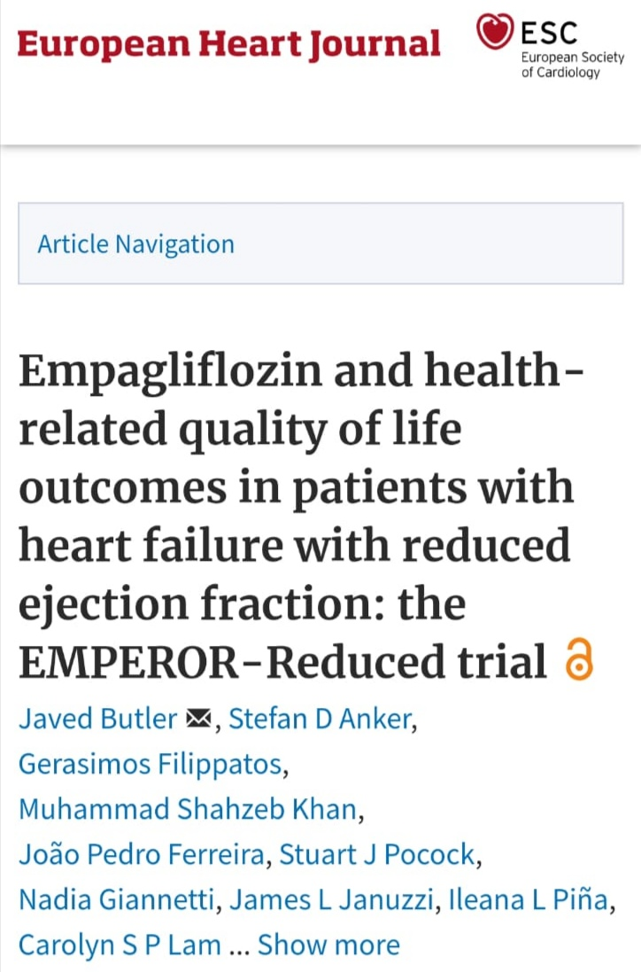

Slide 15
Contribution To Literature :
The EMPEROR-Reduced trial showed that empagliflozin is superior to placebo in improving HF outcomes among patients with symptomatic stable HFrEF (EF ≤40%) on excellent baseline GDMT, irrespective of diabetes status.

Slide 16
Description :
The goal of the trial was to assess the safety & efficacy of empagliflozin in patients with symptomatic heart failure with reduced ejection fraction (HFrEF), irrespective of diabetes status.

Slide 17
Study Design :
Patients were randomized in a 1:1 fashion to either empagliflozin 10 mg (n = 1,863) or matching placebo (n = 1,867).
All the patients were receiving appropriate treatments for heart failure.
Total screened: 7,220
Total number of enrollees: 3730
Duration of follow-up: 16 months (median)
Mean patient age: 67 years
Percentage female: 24%

Slide 18
Inclusion criteria :
Age ≥18 years
Chronic HF, New York Heart Association (NYHA) functional class II/III/IV
Left ventricular EF (LVEF) ≤40%
HF hospitalization within 12 months
N-terminal pro–B-type natriuretic peptide (NT-proBNP ≥600 pg/ml if EF ≤30%; ≥1000 pg/ml if EF 31-35%; ≥2500 pg/ml if EF >35%)
If concomitant atrial fibrillation, then above thresholds were doubled

Slide 19
Exclusion criteria :
Acute coronary syndrome, stroke, or transient ischemic attack (TIA) within 90 days
Listed for orthotopic heart transplantation, currently implanted LV assist device (LVAD)
Cardiomyopathy based on infiltrative/accumulation diseases, muscular dystrophies, reversible causes, hypertrophic cardiomyopathy, pericardial restriction, peripartum, cardiomyopathy caused by chemotherapy within 12 months
Severe valvular heart disease
Acute decompensated HF
Implantable cardioverter-defibrillator (ICD) or cardiac resynchronization therapy (CRT) within 3 months

Slide 20
Principal Findings :
The primary outcome- cardiovascular death or HF hospitalization, for empagliflozin vs. placebo, was 19.4% vs. 24.7% ( p < 0.001)
Cardiovascular death: 10% vs. 10.8% (HR 0.92, 95% CI 0.75-1.12)
HF hospitalization: 13.2% vs. 18.3% (HR 0.69, 95% CI 0.59-0.81)
.

Slide 21
Secondary outcomes :
Total hospitalizations: 388 vs. 553 (p < 0.001)
Composite renal outcome (chronic hemodialysis, renal transplantation, profound sustained reduction in eGFR): 1.6 vs. 3.1 (HR 0.50, 95% CI 0.32-0.77, p < 0.01)
All-cause mortality: 13.4% vs. 14.2% (HR 0.92, 95% CI 0.77-1.10, p > 0.05)
New-onset type 2 diabetes among patients with prediabetes: 11.2% vs. 12.6% (p > 0.05)
Change in hemoglobin A1c between baseline and week 52 (patients with diabetes): -0.28 vs. -0.12% (p < 0.05)

Slide 22
Systolic blood pressure -2.4 vs. -1.7 mm Hg (p > 0.05)
Confirmed hypoglycemic event: 1.4% vs. 1.5%
Death/HF hospitalization/emergent or urgent HF visit requiring intravenous treatment or diuretic intensification/deterioration of NYHA class: 32.7% vs. 43% (p < 0.0001)
Intensification of diuretics: 15.9% vs. 22.2% (p < 0.0001)
Emergent or urgent HF visit requiring intravenous treatment: 6.8% vs. 9.9% (p = 0.0004)
Hospitalization for HF requiring cardiac care unit/intensive care unit care: 4.8% vs. 5.7%
(p = 0.002)

Slide 23
Kansas City Cardiomyopathy Questionnaire-Clinical Summary Score (KCCQ-CSS) : Benefit of empagliflozin vs. placebo was maintained across tertiles of baseline KCCQ-CSS for the primary endpoint, total HF hospitalizations & eGFR slope.
In addition, benefit of empagliflozin vs. placebo for mean KCCQ-CSS was noted as early as 3 months, & noted to be sustained over 12 months.

Slide 24
Interpretation :
The results of this trial indicate that empagliflozin is superior to placebo in improving HF outcomes among patients with symptomatic stable HFrEF (EF ≤40%) on excellent baseline guideline-directed medical therapy (GDMT), irrespective of diabetes status.
Benefit is primarily driven by a reduction in HF hospitalizations, not mortality.
There was an early and sustained benefit on KCCQ-CSS. There was also a benefit in renal outcomes.
The use of MRAs did not influence the effect of empagliflozin on clinical outcomes.
This is a very important trial, & mirrors similar findings from the DAPA-HF trial for dapagliflozin.
Even patients with severe LV dysfunction appeared to benefit.

Slide 25
Of note, the DAPA-HF trial was larger, & did show a benefit in cardiovascular & all-cause mortality with dapagliflozin use.
Even though the sodium-glucose cotransporter 2 (SGLT2) inhibitors were introduced as type 2 diabetes management drugs, the results of the EMPA-REG OUTCOME trial & others indicated a clear benefit in HF management.
This trial enrolled a dedicated HF population, & conclusively shows a benefit in this patient population, irrespective of diabetes status.
These drugs will likely have a prominent role in future HF management guidelines. The mechanism of benefit is unclear.

Slide 26
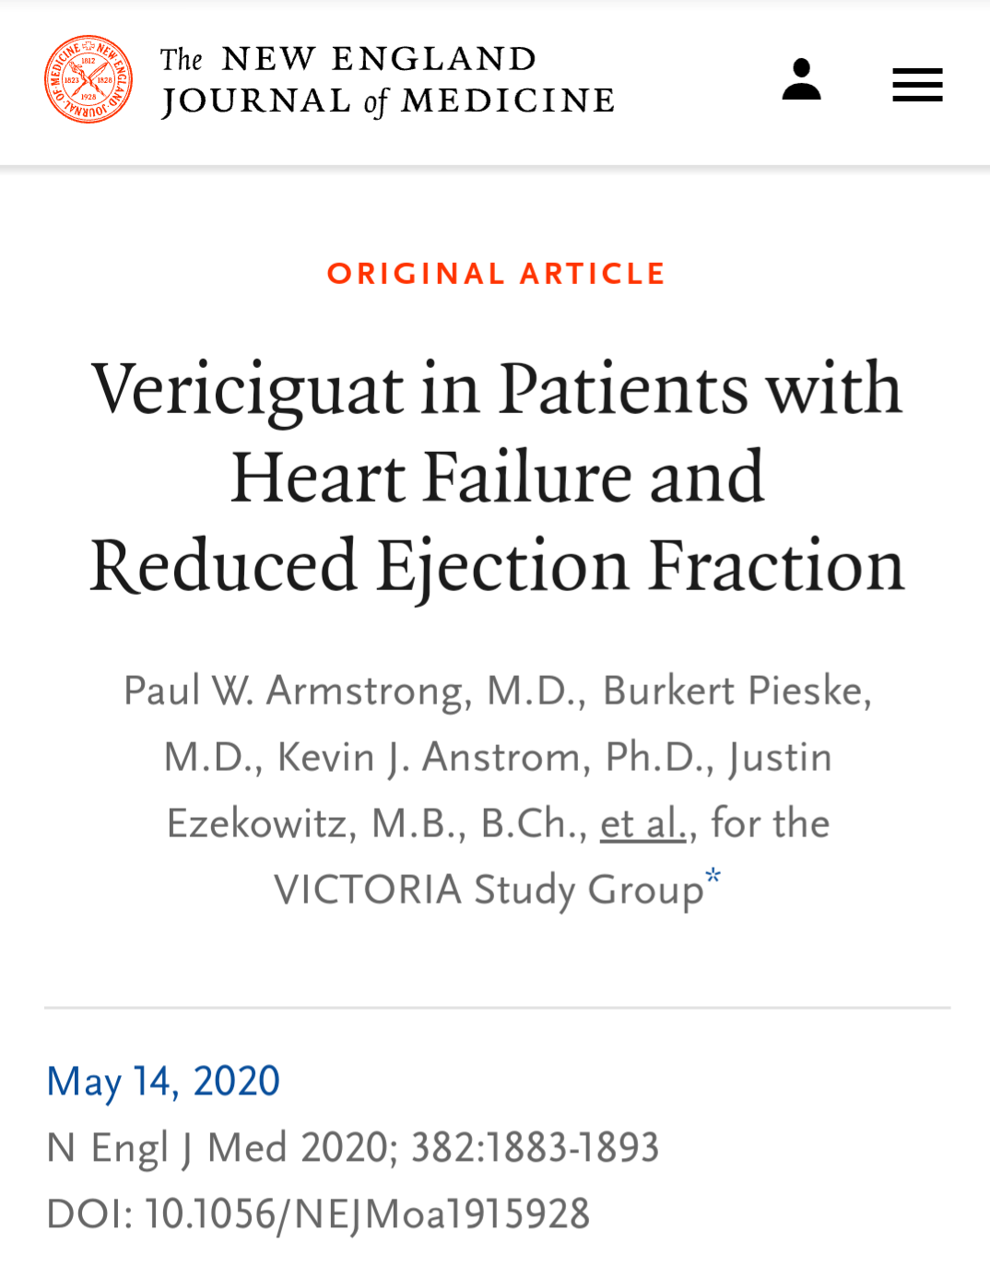

Slide 27
Contribution To Literature :
The VICTORIA trial showed that vericiguat was superior to placebo at improving heart failure outcomes.

Slide 28
Description :
The goal of the trial was to evaluate vericiguat compared with placebo among patients with chronic heart failure (CHF) due to reduced ejection fraction (EF).
Vericiguat increases soluble guanylate cyclase activity.
By stimulating production of cyclic guanosine monophosphate, this may help to improve myocardial & vascular function.

Slide 29
Study Design :
Randomized
Double-blind
Parallel

Slide 30
Patients with CHF were randomized to vericiguat (n = 2,526) versus placebo (n = 2,524).
Vericiguat started at 2.5 mg daily, increased to 5 mg daily, then 10 mg daily.
Total number of enrollees: 5,050
Duration of follow-up: 12 months
Mean patient age: 68 years
Percentage female: 24%

Slide 31
Inclusion criteria :
CHF; New York Heart Association class II-IV, left ventricular EF <45%, & guideline-directed heart failure therapy
Recent heart failure hospitalization or intravenous diuretic use
Elevated natriuretic peptides; N-terminal pro–B-type natriuretic peptide (NT-proBNP) ≥1000 pg/ml (≥1600 pg/ml if atrial fibrillation) or BNP ≥300 pg/ml (≥500 pg/ml if atrial fibrillation)
Clinically stable (systolic blood pressure ≥100 mm Hg & no intravenous diuretics for 24 hours)

Slide 32
Exclusion criteria :
Use of long-acting nitrates, phosphodiesterase type 5 inhibitor, riociguat
Awaiting heart transplantation, continuous intravenous diuretics, or current/anticipated ventricular assist device
Chronic kidney disease (estimated glomerular filtration rate 15 ml/min/1.73 m²) or dialysis
Severe pulmonary disease requiring continuous oxygen
Severe hepatic insufficiency
Correctable cardiac comorbidities

Slide 33
Principal Findings :
The primary outcome, cardiovascular death or hospitalization for heart failure, occurred in 35.5% of the vericiguat group compared with 38.5% of the placebo group (hazard ratio [HR] 0.90, p = 0.019).
The risk of the primary outcome for vericiguat vs. placebo: among those aged <75 years (HR 0.84) & those ≥75 years (HR 1.04) (p for interaction = 0.030).

Slide 34
Interpretation :
Among patients with CHF with recent decompensation, a novel strategy of increasing soluble guanylate cyclase activity with vericiguat was effective.
Vericiguat compared with placebo was effective at reducing cardiovascular death or hospitalization for heart failure.
There was a possible enhanced benefit among patients <75 years of age.

Slide 35
There was no apparent reduction in all-cause mortality with vericiguat compared with placebo.
Vericiguat was safe & well tolerated & did not require monitoring of renal function or electrolytes.
Vericiguat may represent a novel treatment among patients with recent heart failure decompensation.

Slide 36
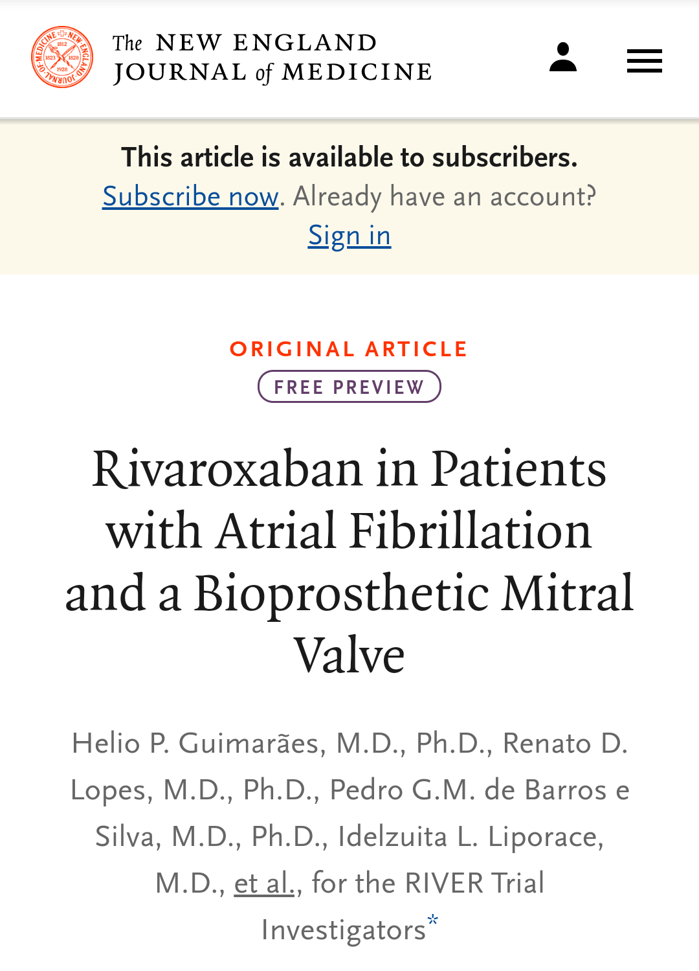

Slide 37
Contribution To Literature :
The RIVER trial showed that rivaroxaban is noninferior to warfarin for prevention of thromboembolic events among patients with AF/AFL & a bioprosthetic mitral valve.

Slide 38
Description :
The goal of the trial was to assess the safety & efficacy of rivaroxaban compared with warfarin for patients with a bioprosthetic mitral valve & evidence of atrial fibrillation (AF) or flutter (AFL).

Slide 39
Study Design :
Patients were randomized in a 1:1 open-label fashion to either rivaroxaban 20 (15 mg daily if creatinine clearance was 30-49) or warfarin with an international normalized ratio (INR) goal of
2-3.
Usual care was provided at the discretion of the clinicians.
Total number of enrollees: 1,005
Duration of follow-up: 1 year
Mean patient age: 59.3 years
Percentage female: 60.4%

Slide 40
Inclusion criteria :
Age ≥18 years
AF or AFL
Bioprosthetic mitral valve
Receiving or planned use of oral anticoagulant (OAC) for thromboembolism prophylaxis >48 hours from mitral valve surgery

Slide 41
Exclusion criteria :
Contraindication to rivaroxaban or warfarin
Extremely high risk of bleeding
Transient postoperative AF
Mechanical valves

Slide 42
Other salient features/characteristics :
Mean CHA₂DS₂-VASc score: 2.6
Mean HAS-BLED score: 1.6
Interval between mitral valve surgery & randomization: <3 months: 18%, 3 months-<1 year: 16.8%, 1-<5 years: 32.2%, ≥5 years: 30.6%

Slide 43
Principal Findings :
The mean time to the primary outcome (death, major adverse cardiac events, major bleeding) for rivaroxaban vs. warfarin was 347.5 vs. 340.1 days (p < 0.0001 for noninferiority, p = 0.1 for superiority).

Slide 44
Secondary outcomes for rivaroxaban vs. warfarin :
Cardiovascular death or thromboembolic event: 3.4% vs. 5.1% (hazard ratio [HR] 0.65, 95% confidence interval [CI] 0.35-1.20)
Any stroke: 0.6% vs. 2.4% (HR 0.25, 95% CI 0.07-0.88)
Valve thrombosis: 1% vs. 0.6%
Any bleeding: 13.0% vs. 15.4% (HR 0.83, 95% CI 0.59-1.15)

Slide 45
Interpretation :
The results of this trial indicate that rivaroxaban is noninferior to warfarin for prevention of thromboembolic events among patients with AF/AFL & a bioprosthetic mitral valve.
All strokes were lower with rivaroxaban.
This is one of the first trials to directly evaluate the role of a direct OAC (DOAC) in patients with mitral valve disease & atrial arrhythmias.

Slide 46
Historically, these patients have been treated with warfarin.
Although this trial has limitations (open-label design, etc.), these findings are likely to be practice changing.
The only caveat is that it is unclear if the mitral valve surgery was for rheumatic heart disease, in particular mitral stenosis, where warfarin is still recommended as the OAC of choice.

Slide 47
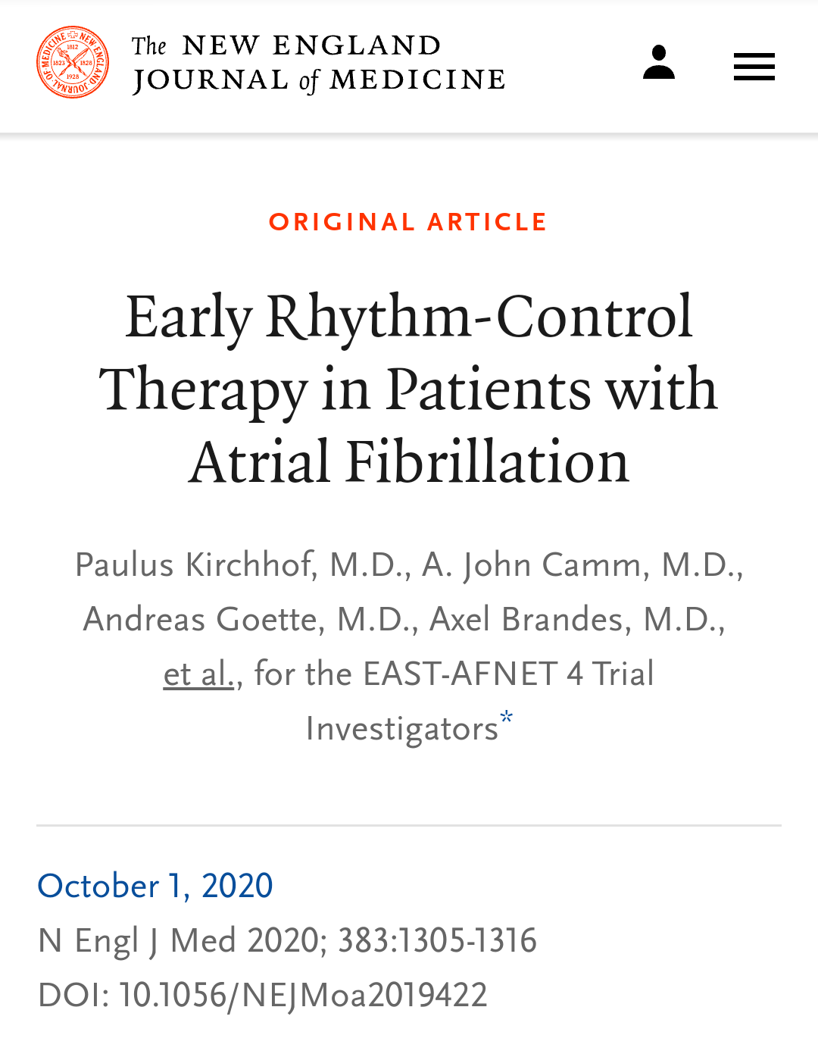

Slide 48
Contribution To Literature :
The EAST-AFNET 4 trial showed that a rhythm-control strategy is superior to usual care in improving cardiovascular (CV) outcomes at 5 years among patients with recent diagnosis of AF & concomitant CV conditions.

Slide 49
Description :
The goal of the trial was to compare a rhythm-control strategy vs. usual care (rate control in the majority of cases) among patients with a recent diagnosis of atrial fibrillation (AF).

Slide 50
Study Design :
Patients with AF diagnosis within 1 year were randomized in a 1:1 fashion to either rhythm control (n = 1,395) or usual care (n = 1,394).
Early rhythm control required antiarrhythmic drugs or AF ablation, as well as cardioversion of persistent AF, to be initiated early after randomization.
Usual care was initially treated with rate-control therapy without rhythm control.

Slide 51
Total screened: 2,810
Total number of enrollees: 2,789
Duration of follow-up: 5.1 years
Mean patient age: 70.3 years
Percentage female: 46%

Slide 52
Inclusion criteria :
Early AF (AF diagnosed within 1 year) & >75 years of age & had a previous transient ischemic attack (TIA) or stroke, OR
Met two of the following criteria: age >65 years, female sex, heart failure (HF), hypertension, diabetes mellitus, severe coronary artery disease, chronic kidney disease, left ventricular hypertrophy (diastolic septal wall width >15 mm)

Slide 53
Other salient features/characteristics :
First AF: 38%, paroxysmal: 36%
Median days since AF diagnosis: 36
HF: 29%
Prior CVA/TIA: 11%
Oral anticoagulant: 90%
Beta-blocker: 80%
In the rhythm-control arm, initial choice of strategy was flecainide 36%, amiodarone 20%, AF ablation 8%

Slide 54
Principal Findings :
The trial was stopped early due to efficacy.
The primary outcome, CV death, stroke, hospitalization for HF, or acute coronary syndrome (ACS), for rhythm control vs. usual care, was 3.9 vs. 5.0/100 person-years ( p = 0.005).
CV death: 1 vs. 1.3/100 P-Y (HR 0.72, 95% CI 0.52-0.98)
Stroke: 0.6 vs. 0.9/100 P-Y (HR 0.65, 95% CI 0.44-0.98)
HF hospitalization: 2.1 vs. 2.6/100 P-Y
ACS hospitalization: 0.8 vs. 1.0/100 P-Y

Slide 55
Secondary outcomes for rhythm control vs. usual care :
Nights spent in the hospital: 5.8 vs. 5.1 days
Change in left ventricular ejection fraction at 2 years: 1.5 vs. 0.8%
Sinus rhythm: 82.1% vs. 60.5% (p < 0.05)
All-cause mortality: 9.9% vs. 11.8%
Adverse event related to rhythm-control therapy: 4.9% vs. 1.4%

Slide 56
Interpretation :
The results of this important trial indicate that a rhythm-control strategy is superior to usual care (rate control in the majority of cases) in improving CV outcomes at 5 years among patients with recent diagnosis of AF & concomitant CV conditions.
Significant reductions were noted for the primary composite endpoint, as well as for CV death & stroke.
Results of this trial are different from other similar trials such as CABANA-AF, AFFIRM, & RACE.
One difference is the population enrolled – recent onset (within 12 months) in EAST-AFNET 4 vs. more sustained AF in the other trials.

Slide 57
There was also a reasonably high rate of AF ablation (8% at enrollment, 20% by 5 years) in the current trial.
Of note, this trial is only single-blinded (not to intervention received).
That could confound assessment of the various endpoints.
Based on recent experiences from important sham-controlled trials (SYMPLICITY, ORBITA), these findings should prompt consideration for a sham-controlled trial to assess the true efficacy of catheter ablation in modulating CV outcomes among patients with AF.

Slide 58
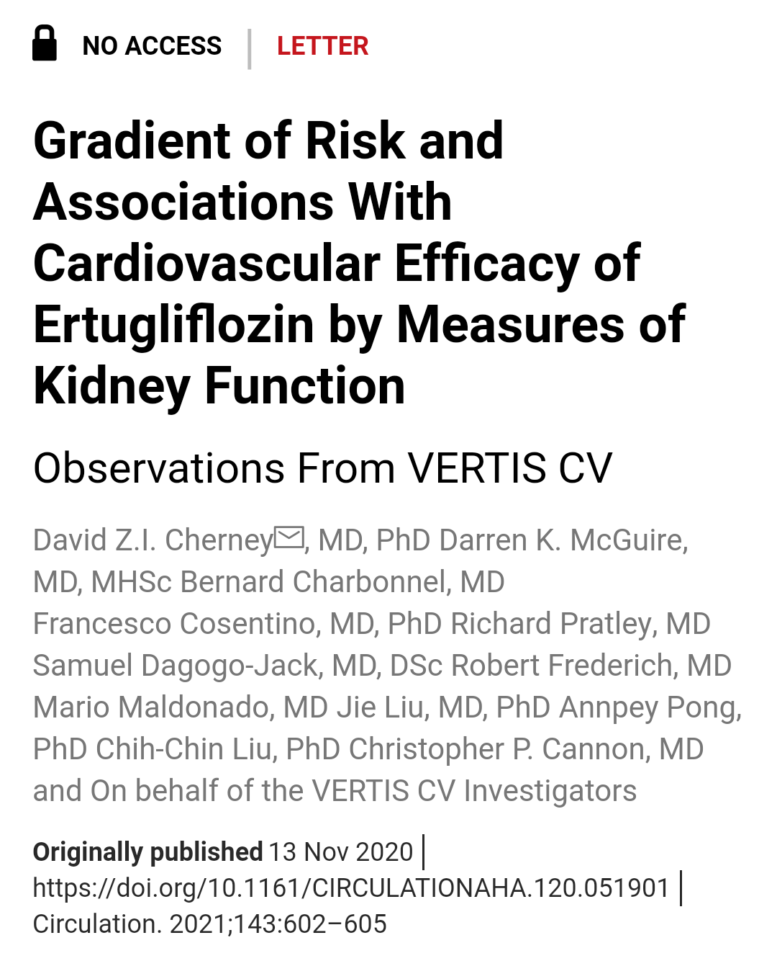

Slide 59
Contribution To Literature :
The VERTIS CV trial showed that ertugliflozin is noninferior for reducing CV events in patients with T2DM & established CVD.
The effects, especially on HF, were consistent with the benefits seen in the SGLT2 inhibitor class.

Slide 60
Description :
The goal of the trial was to assess the cardiovascular (CV) safety of ertugliflozin in patients with type 2 diabetes mellitus (T2DM) & established atherosclerotic cardiovascular disease (ASCVD).

Slide 61
Study Design :
Patients were randomized in a 1:1:1 fashion to either ertugliflozin 5 mg (n = 2,752), 15 mg (n = 2,747), or matching placebo (n = 2,747).
Total number of enrollees: 8,246
Duration of follow-up: 3.5 years
Mean patient age: 64.4 years
Percentage female: 30%

Slide 62
Inclusion criteria :
Age ≥40 years
T2DM diagnosis according to American Diabetes Association (ADA) guidelines: glycated hemoglobin (HbA1c) 7.0-10.5% (53-91 mmol/mol)
Established ASCVD involving the coronary, cerebrovascular, &/or peripheral artery systems
Stable on allowable antihyperglycemic agents (AHAs) or on no background AHA for ≥8 weeks prior to study participation

Slide 63
Exclusion criteria :
History of type 1 DM or ketoacidosis
Experiencing a CV event (e.g., myocardial infarction [MI] or stroke) or undergoing coronary or peripheral intervention procedure between the screening visit & randomization
Undergoing any CV surgery (e.g., valvular surgery) within 3 months of the screening visit

Slide 64
Planned revascularization or peripheral intervention procedure or other CV surgery
Estimated glomerular filtration rate (eGFR) <30 ml/min/1.73 m² at the screening visit
New York Heart Association class IV heart failure (HF) at screening visit (class III-IV prior to protocol amendment)

Slide 65
Principal Findings :
The primary outcome, CV death, nonfatal MI, or stroke for ertugliflozin vs. placebo: 11.9% vs. 11.9% (hazard ratio [HR] 0.97, 95% confidence interval [CI] 0.85-1.11, p < 0.001 for noninferiority)
CV death: 1.8% vs. 1.9% (p = 0.39)
MI: 1.7% vs. 1.6% (p = 0.66)
Stroke: 0.8% vs. 0.8% (p = 0.99)

Slide 66
Secondary outcomes :
HF hospitalization: 2.5% vs. 3.6% (p = 0.006)
HbA1c at 18 weeks for 5 mg ertugliflozin vs. placebo: -0.5% (p < 0.0001)
HbA1c at 18 weeks for 15 mg ertugliflozin vs. placebo: -0.5% (p < 0.0001)
Mean decrease in body weight for ertugliflozin 5 mg vs. placebo: 2.4 kg; for ertugliflozin 15 mg vs. placebo: 2.8 kg
Symptomatic hypoglycemic event: 27.2% vs. 28.8%
Urinary tract infection: 12.1% vs. 10.2% (p < 0.05)
Amputation: 2.0% vs. 1.6% (p > 0.05)

Slide 67
Renal outcomes :
Renal composite (renal death, dialysis/transplant, doubling of serum creatinine): 3.2% vs. 3.9% (p = 0.08)

Slide 68
HF outcomes :
Time to first HF hospitalization for ertugliflozin vs. placebo, was 0.73 vs. 1.05 events/100 person-years (HR 0.70, 95% CI 0.54-0.90, p = 0.006).
The benefit was consistent across ertugliflozin dose.
History of HF and EF ≤45%/>45%.
Total & recurrent HF events were also reduced in the ertugliflozin arm.
On subgroup analysis, effects were more pronounced among patients with eGFR <60 (p = 0.04), presence of macro- or microalbuminuria (p = 0.04), & patients already on diuretic (p = 0.02).

Slide 69
Effect of baseline renal function :
The proportion of patients with chronic kidney disease (CKD) stages 1, 2, & 3 at baseline was 25%, 53%, & 22%, respectively; 60% & 40% of patients had normal & elevated albuminuria, respectively, while 49%, 32%, & 19% were classified into the KDIGO (Kidney Disease Improving Global Outcomes) CKD low-, moderate-, & high-/very high-risk categories.

Slide 70
For the endpoint of hospitalization for heart failure (HHF)/CV death, a greater benefit was observed among patients with albuminuria with ertugliflozin vs. placebo (33.5% vs. 45.8%, p for interaction = 0.01), & for KDIGO moderate (23.1% vs. 30.3%) & high/very high risk (47.0% vs. 61.1%) for ertugliflozin vs. placebo, respectively (p for interaction = 0.03).
A similar finding was noted for the endpoint of HHF.

Slide 71
Interpretation :
The results of this trial indicate that ertugliflozin is noninferior to placebo for reducing CV events in patients with T2DM & established CVD.
Trends were noted for beneficial effect on renal outcomes, although this was not statistically significant.
Subgroup analysis suggested a benefit for HHF & HHF/CV death with ertugliflozin vs. placebo among patients with higher risk (presence of albuminuria, higher KDIGO class).

Slide 72
This is the fourth sodium glucose cotransporter-2 (SGLT2) drug to report on CV outcomes (after empagliflozin, canagliflozin, and dapagliflozin).
There appeared to be a consistent class effect with respect to reductions in HF hospitalizations, but major adverse cardiac event reductions were statistically significant only for canagliflozin & empagliflozin.
Unlike canagliflozin, no safety signals with respect to amputations were noted.

Slide 73
The salutary effects of ertugliflozin appear to be somewhat diminished compared with canagliflozin & empagliflozin; it is unclear if this represents a difference in patient populations between the trials, or a true biological difference in drug efficacy (or other issues).
Overall, these are important findings, even as SGLT2 inhibitors are becoming first-line agents for patients with T2DM, & also for patients with HF, with or without DM.
These results add to the body of evidence supporting the use of this class in the guidelines.

Slide 74
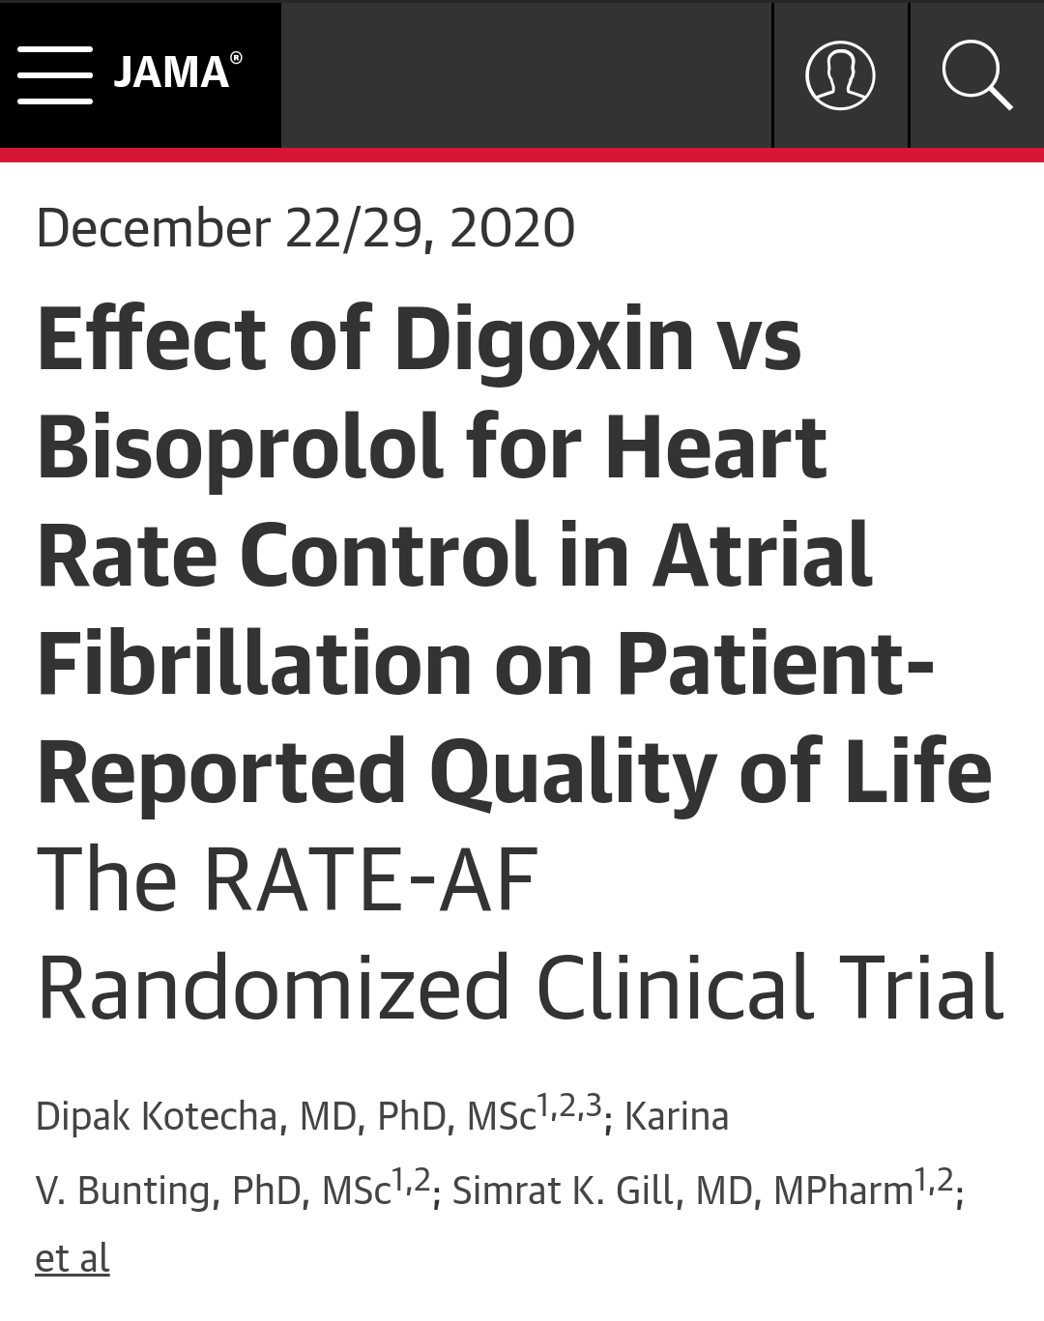

Slide 75
Contribution To Literature :
The RATE-AF trial showed that digoxin was associated with symptom improvement & reduction in NT-proBNP compared with a beta-blocker.

Slide 76
Description :
The goal of the trial was to evaluate digoxin compared with beta-blocker among patients with permanent atrial fibrillation.

Slide 77
Study Design :
Randomized
Parallel
Open-label

Slide 78
Eligible patients were randomized to digoxin (n = 80) vs. beta-blocker (n = 80).
Patients randomized to a beta-blocker received bisoprolol.
Total number of enrollees: 160
Duration of follow-up: 12 months
Mean patient age: 76 years
Percentage female: 46%

Slide 79
Inclusion criteria :
≥60 years of age
Permanent atrial fibrillation
New York Heart Association (NYHA) ≥ class II
Exclusion criteria :
Heart rate <60 bpm
Need for beta-blocker based on heart failure or ejection fraction (EF)

Slide 80
Other salient features/characteristics :
Heart rate reduction was similar between treatment groups at 12 months
Principal Findings :
The primary outcome, patient-reported quality of life at 6 months, was similar between the groups (p = 0.30). Some quality of life measures favored digoxin at 12 months.

Slide 81
Secondary outcomes :
NYHA class: In the digoxin group, 2.4 at baseline and 1.5 at 12 months. In the beta-blocker group, 2.4 at baseline & 2.0 at 12 months (p < 0.001).
N-terminal pro–B-type natriuretic peptide (NT-proBNP): In the digoxin group, 1,095 at baseline & 960 at 12 months. In the beta-blocker group, 1,041 at baseline & 1,250 at 12 months
(p = 0.005).

Slide 82
Left ventricular EF (LVEF): In the digoxin group, 56.2% at baseline & 59.7% at 12 months. In the beta-blocker group, 57.6% at baseline & 59.8% at 12 months (p = 0.45).
Adverse events: In the digoxin group, there were 29 events vs. 142 events in the beta-blocker group (p < 0.001).

Slide 83
Interpretation :
Among patients with permanent atrial fibrillation, digoxin compared with beta-blocker failed to improve quality of life measures at 6 months.
Despite lack of benefit for digoxin on the primary outcome, digoxin improved some measures of quality of life at 12 months & was associated with greater reductions in NYHA class & NT-proBNP.
Digoxin was also associated with fewer adverse events compared with beta-blockers.

Slide 84
Randomized Trial of Transfusion Strategies in Patients With Myocardial Infarction and Anemia - REALITY

Slide 85
Contribution To Literature :
The REALITY trial showed that a restrictive PRBC transfusion strategy (transfusion for Hb ≤8 g/dl, goal Hb 8-10 g/dl) is noninferior to a more liberal strategy (transfusion for Hb ≤10 g/dl, goal Hgb >11 g/dl).

Slide 86
Description :
The goal of the trial was to assess the safety & efficacy of a restrictive versus liberal red blood cell (RBC) transfusion strategy among patients with acute myocardial infarction (AMI) & anemia.

Slide 87
Study Design :
Patients with AMI & hemoglobin (Hgb) ≤8 to ≤10 g/dl during admission were randomized in a 1:1 fashion to either a liberal (for Hgb ≤10 g/dl, goal Hgb >11 g/dl) (n = 342) or a restrictive (for Hgb ≤8 g/dl, target Hgb 8-10 g/dl) (n = 324) RBC transfusion strategy.
The strategies should be maintained until discharge from hospital or for 30 days, whichever comes first.
Total number of enrollees: 666
Duration of follow-up: 30 days
Mean patient age: 77 years
Percentage female: 43%

Slide 88
Inclusion criteria :
MI (ST-segment elevation MI [STEMI] or NSTEMI)
  Last ischemic symptoms <48 hours before admission
  Troponin elevation
Anemia: Hb ≤10g/dl but >7 g/dl, at any time of index hospitalization for MI

Slide 89
Exclusion criteria :
Cardiogenic shock
Post-percutaneous coronary intervention (PCI) or post-coronary artery bypass grafting (CABG) MI
Transfusion in the previous 30 days
Any known hematologic disease
Massive bleeding or compromising vital prognosis

Slide 90
Other salient features/characteristics :
Prior acute coronary syndrome (ACS): 36%
Prior PCI: 34%
Chronic anemia: 18%
On admission: NSTEMI: 70%, coronary angiography: 80%, PCI: 59%, CABG: 4%
Mean units of packed RBCs (PRBCs) per patient for restrictive vs. liberal transfusion strategy: 2.9 vs. 2.8
At least 1 unit PRBCs: 35.7% vs. 99.4%
(p < 0.0001)

Slide 91
Principal Findings :
The primary outcome, all-cause death, reinfarction, stroke, & emergency revascularization prompted by ischemia for restrictive vs. liberal transfusion strategy, was 11.0% vs. 14.0% ( p < 0.05 for noninferiority, p = 0.22 for superiority)
All-cause mortality: 5.6% vs. 7.7% (p > 0.05)
Recurrent MI: 2.1% vs. 3.1%
Emergency revascularization: 1.5% vs. 1.9%

Slide 92
Secondary outcomes for restrictive vs. liberal transfusion strategy :
Acute renal failure: 9.7% vs. 7.1% (p = 0.24)
Infection: 0% vs. 1.5% (p = 0.03)
Acute lung injury: 0.3% vs. 2.2% (p = 0.03)
Length of stay: 7.0 vs. 7.0 days (p = 0.84)
Total 30-day hospital costs: €11,051 vs. €12,572 (p = 0.1)

Slide 93
Interpretation :
The results of this trial indicate that a restrictive PRBC transfusion strategy (transfusion for Hgb ≤8 g/dl, goal 8-10 g/dl) is noninferior to a more liberal strategy (transfusion for Hgb ≤10 g/dl, goal Hgb >11 g/dl).
In addition, infections & acute lung injury were higher with a more liberal strategy.
Total blood utilization & costs were both lower with the restrictive strategy; this strategy was considered cost-dominant.

Slide 94
This is an important trial, & argues against the 10/30 rule that was once commonly practiced post-ACS.
One minor point is that transfusions are frequently administered for Hgb ≤7 in clinical practice in the United States; the threshold studied in this trial was slightly higher (8 g/dl),.
Similar results in favor of a restrictive strategy have been noted for post-cardiac and noncardiac surgery patients.

Slide 95
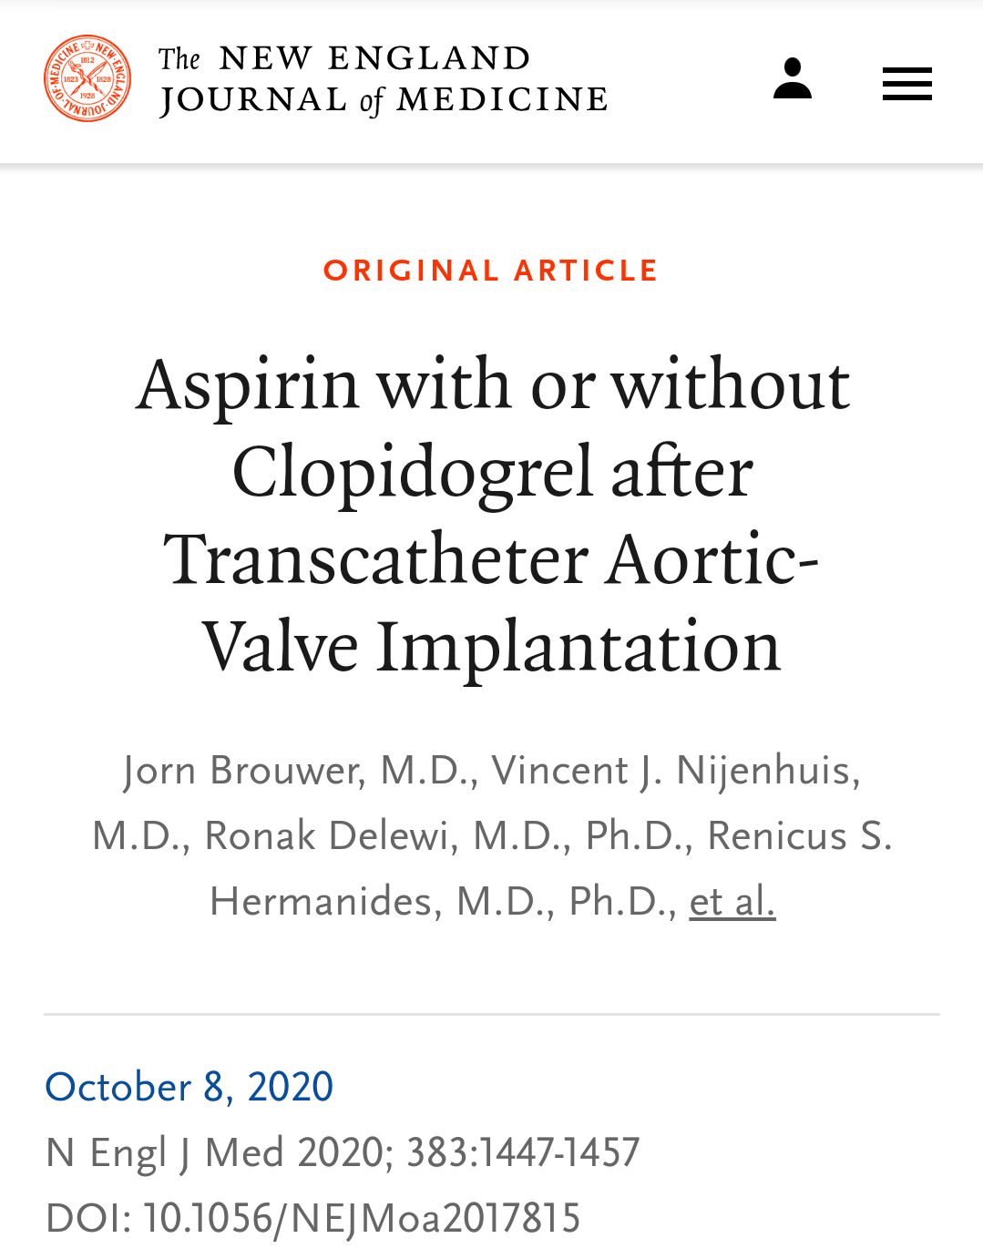

Slide 96
Contribution To Literature :
The POPular TAVI (antiplatelet therapy) trial showed that aspirin alone was preferential to aspirin plus clopidogrel after TAVR.

Slide 97
Description :
The goal of the trial was to evaluate aspirin alone compared with aspirin plus clopidogrel among patients who underwent transcatheter aortic valve replacement (TAVR) & did not have a long-term indication for oral anticoagulation.

Slide 98
Study Design :
Randomized
Parallel
Open-label

Slide 99
Eligible patients who underwent TAVR were randomized to aspirin alone (n = 331) versus aspirin & clopidogrel for 3 months (n = 334).
Total number of enrollees: 690
Duration of follow-up: 12 months
Mean patient age: 80 years
Percentage female: 50%
Percentage with diabetes: 24%

Slide 100
Inclusion criteria :
Patients who underwent TAVR & did not have an indication for anticoagulation therapy
Exclusion criteria :
Implantation of a drug-eluting stent within the last 3 months or bare-metal stent within the last month

Slide 101
Principal Findings :
The primary co-outcome, all bleeding (minor, major, & life-threatening or disabling bleeding) at 12 months, occurred in 15.1% of the aspirin alone group compared with 26.6% of the aspirin plus clopidogrel group (p = 0.001).
The primary co-outcome, nonprocedure-related bleeding at 12 months, occurred in 15.1% of the aspirin alone group compared with 24.9% of the aspirin plus clopidogrel group (p = 0.005).

Slide 102
Secondary outcomes :
Cardiovascular death, nonprocedure-related bleeding, stroke, or myocardial infarction at 12 months: 23.0% of the aspirin alone group compared with 31.1% of the aspirin plus clopidogrel group (p for noninferiority < 0.001, p for superiority 0.04)
Cardiovascular death, stroke, or myocardial infarction at 12 months: 9.7% of the aspirin alone group compared with 9.9% of the aspirin plus clopidogrel group (p for noninferiority = 0.004, p for superiority 0.93)
VARC(valve academic research consortium) major bleeding at 12 months: 2.4% of the aspirin alone group compared with 7.5% of the aspirin plus clopidogrel group (p < 0.05)

Slide 103
VARC major, life-threatening, or disabling bleeding at 12 months: 5.1% of the aspirin alone group compared with 10.8% of the aspirin plus clopidogrel group (p < 0.05)
Symptomatic aortic valve thrombosis at 12 months: 0.9% of the aspirin alone group compared with 0.3% of the aspirin plus clopidogrel group (p = nonsignificant)
Increased aortic valve gradient >10 mm Hg at 12 months: 3.0% of the aspirin alone group compared with 3.3% of the aspirin plus clopidogrel group

Slide 104
Interpretation :
Among patients who underwent TAVR & did not have an indication for anticoagulation, aspirin alone was associated with a reduction in all bleeding & nonprocedure-related bleeding compared with aspirin plus clopidogrel.
This benefit was largely due to a significant reduction in major bleeding events.
Aspirin alone compared with aspirin plus clopidogrel was also associated with noninferiority regarding adverse ischemic events (cardiovascular death, stroke, or myocardial infarction).

Slide 105
Valve function appeared to remain similar within 12 months.
The results of this study are similar to the ARTE trial.
A limitation of the trial is open-label design.
This trial casts some doubt on the arbitrary practice of dual antiplatelet therapy after TAVR.

Slide 106
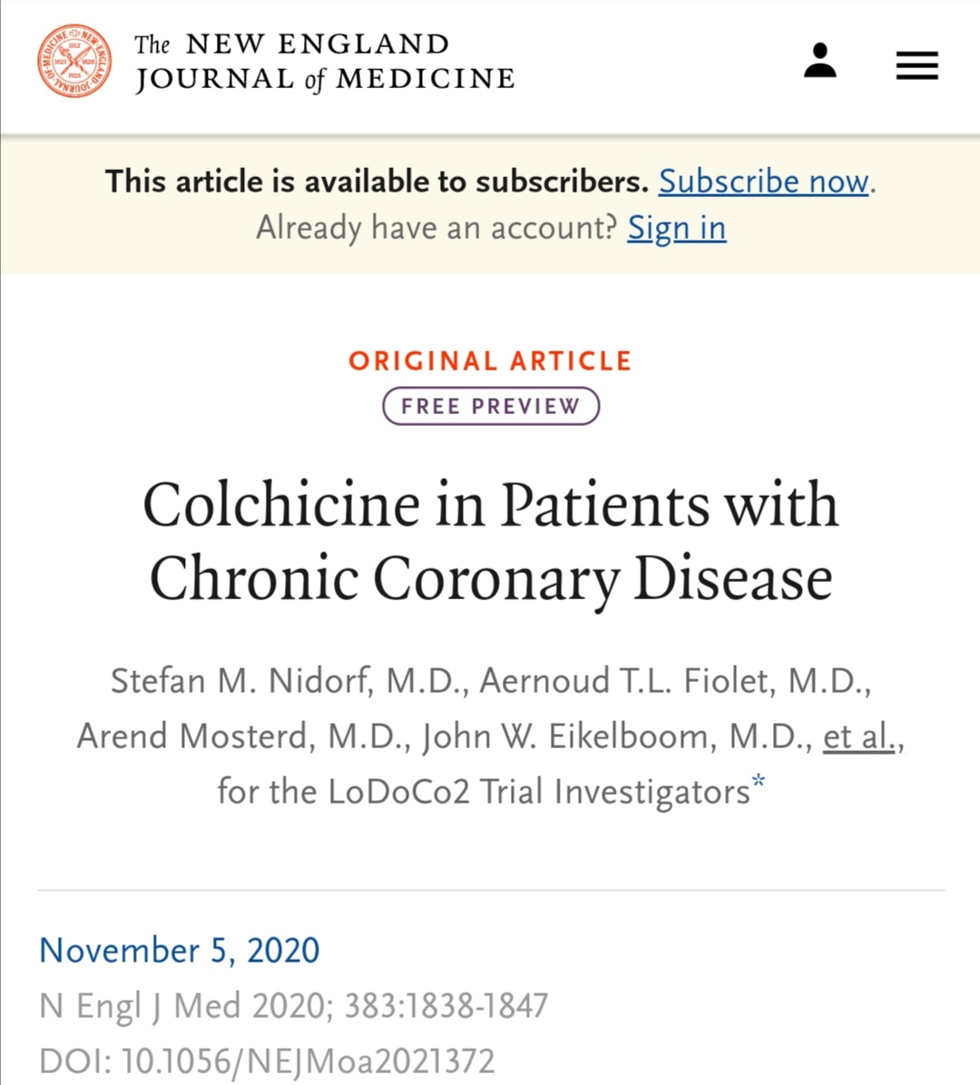

Slide 107
Contribution To Literature :
The LoDoCo2 trial showed that colchicine improves CV outcomes (primarily MI & ischemia-driven revascularization) among patients with chronic coronary disease compared with placebo.
However, there was a signal towards higher non-CV mortality with colchicine.

Slide 108
Description :
The goal of the trial was to assess the safety & efficacy of colchicine in patients with chronic coronary disease.

Slide 109
Study Design :
Patients were randomized in a 1:1 fashion to either colchicine 0.5 mg daily or matching placebo.
Total number of enrollees: 5,522
Duration of follow-up: 28.6 months (median)
Mean patient age: 66 years
Percentage female: 15.3%

Slide 110
Inclusion criteria :
Age 35-82 years
Evidence of coronary disease on invasive coronary angiography or computed tomography
Angiography or a coronary artery calcium score of ≥400 Agatston units on a coronary artery calcium scan
Clinically stable condition for ≥6 months

Slide 111
Exclusion criteria :
Moderate-to-severe renal impairment
Severe heart failure
Severe valvular heart disease
Known side effects from colchicine

Slide 112
Other salient features/characteristics :
History of acute coronary syndrome: 84%
Prior coronary revascularization: 84%
Single antiplatelet: 67%, dual antiplatelet: 23%, statin: 94%

Slide 113
Principal Findings :
The primary outcome, cardiovascular (CV) death, myocardial infarction (MI), stroke, ischemia-driven revascularization, for colchicine vs. placebo, was 6.8% vs. 9.6% ( p < 0.001).
MI: 3.0% vs. 4.2% (p = 0.01)
Ischemic stroke: 0.6% vs. 0.9% (p = 0.2)
Ischemia-driven revascularization: 4.9% vs. 6.4% (p = 0.01)
CV mortality: 0.7% vs. 0.9% (p > 0.05)

Slide 114
Secondary outcomes for colchicine vs. placebo :
All-cause mortality: 2.6% vs. 2.2% (p > 0.05)
Non-CV death: 0.7 vs. 0.5 events/100 patient-years (HR 1.51, 95% CI 0.99-2.31)
Hospitalization for pneumonia: 1.7% vs. 2.0%

Slide 115
Interpretation :
The results of this trial indicate that colchicine improves CV outcomes among patients with chronic coronary disease compared with placebo.
Reductions were noted in MI & ischemia-driven revascularization.
However, there was a signal towards higher non-CV mortality with colchicine.
Etiology was unclear, but hospitalizations for infections & pneumonia were similar between the two arms.

Slide 116
These are interesting findings. The COLCOT trial showed a benefit in ischemic outcomes among a similar high-risk population.
In that trial, there was a neutral effect on death (1.8% vs. 1.8%) & benefit was predominantly driven by a reduction in urgent revascularizations.
COPS was a smaller trial in ACS patients that showed a similar benefit in revascularization, but with a significantly higher risk of non-CV mortality (5 vs. 0, p = 0.02).
It is unclear if this is a true signal or a chance finding, but will need to be carefully assessed going forward.
Discontinuations due to side effects are frequent with colchicine; in this trial, 15% did not undergo randomization after enrollment in the run-in phase due to side effects.

Slide 117
THANK YOU

